Slide 1

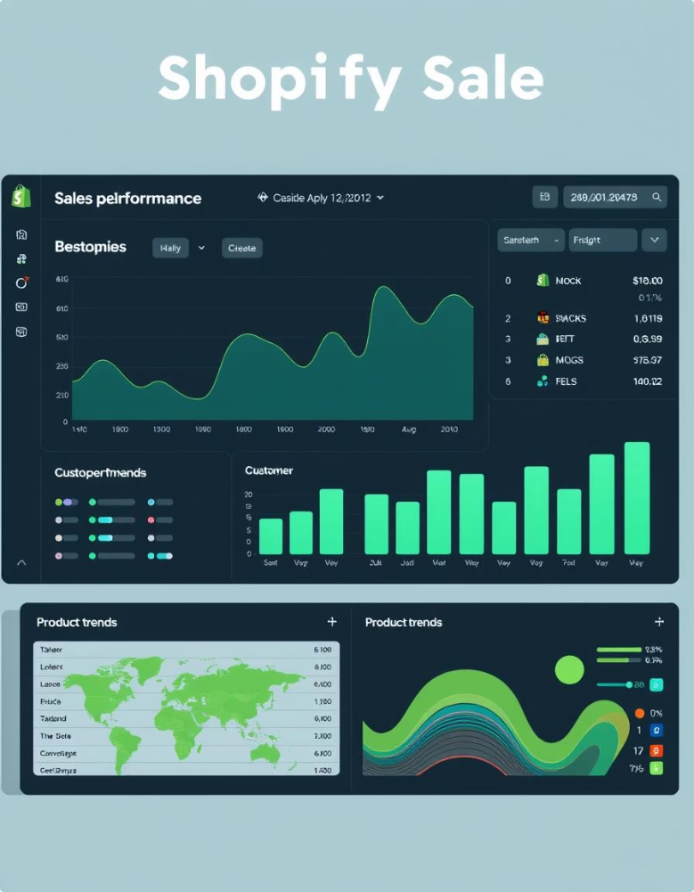
Shopify Sales Dashboard Report
This report provides key insights into Shopify sales data.
It covers sales performance, customer behavior, and product trends.

Slide 2
Project Overview
This project combines Power BI, Python, and Excel to analyze 7,431 Shopify orders. It focuses on uncovering sales trends, customer behavior, and operational insights. The data covers multiple months, ensuring comprehensive and actionable results to drive business decisions.
Using clean, detailed datasets allows accurate visualizations and performance tracking. This integrated approach supports stronger strategic planning and marketing initiatives.
Tools Used
Dataset
Purpose
Power BI for interactive dashboards
7,431 cleaned Shopify orders
Reveal customer buying patterns
Data spans multiple months
Identify top products and regions
Python for exploratory data analysis
Includes sales and customer details
Support revenue growth and retention
Excel for data organization and calculations

Slide 3

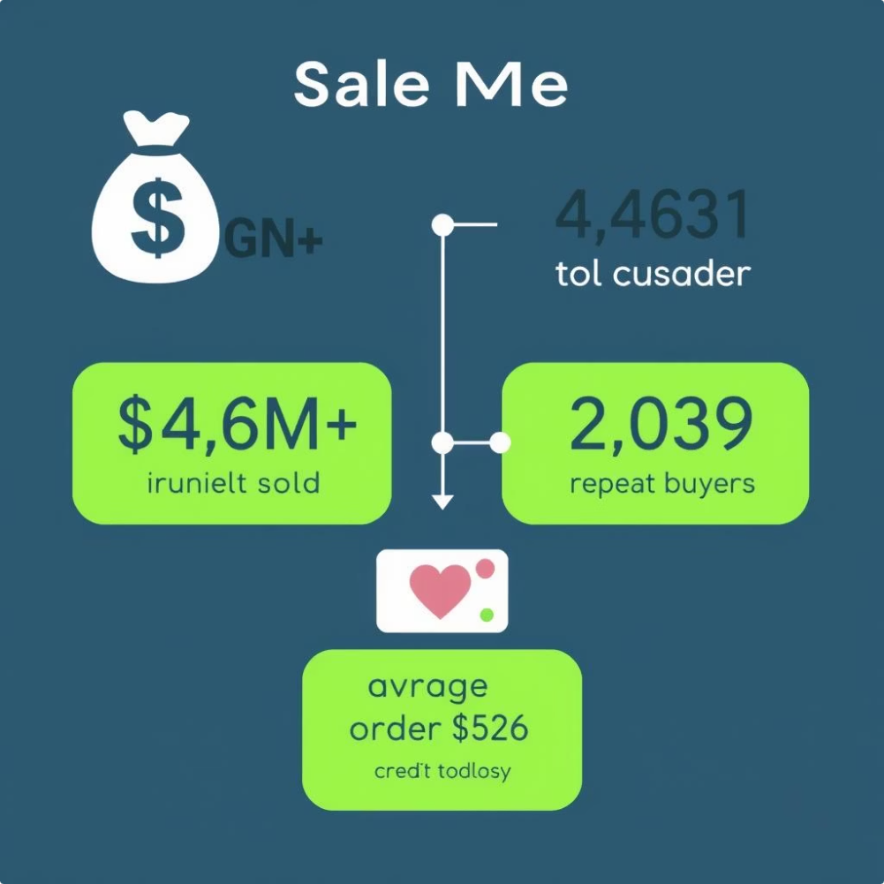
Key Sales Insights
$4.6M+
4,431
$526
Net Sales
Total Customers
Average Order Value
Generated from 7,431 units sold.
Including 2,039 repeat buyers.
Reflecting strong customer engagement.

Slide 4
Dashboard Breakdown: Key Performance Indicators
Net Sales: $4M
Total Customers: 4431
Average Order Value: $562.6
Order Volume: $944
Customer Retention Rate: 46%

Slide 5




Dashboard Breakdown: Key Performance Indicators
Net Sales
Total Customers
The total revenue from 7,431 units sold is $4 million.
A customer base of 4,431 buyers, including 2,039 repeat buyers.
Average Order Value
Customer Retention Rate
Orders average $562.6, signaling strong buying power.
Retention stands at 46%, highlighting loyal repeat business.

Slide 6

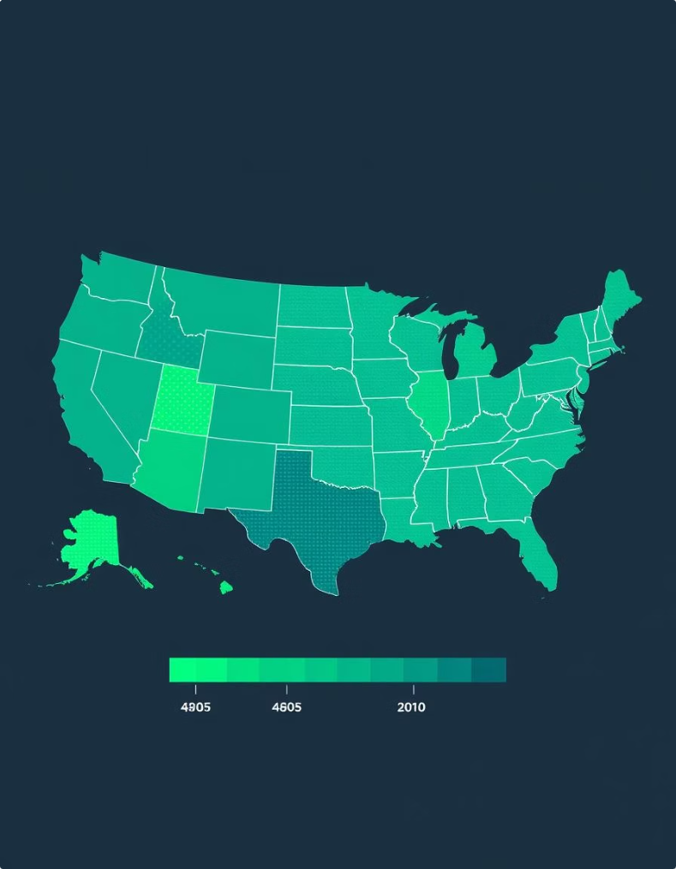
Regional Sales Performance
Province Map
This map uses colors to show sales performance across all US states. Darker colors mean higher sales, making it easy to see which states are doing best and which need more attention.
City Bubble Map
This map shows customer numbers or sales revenue for each city using bubbles. Bigger bubbles mean more customers or higher sales, helping us understand how well we're doing in different cities.
City Bar Chart
This chart lists the top 10 cities based on sales or customer count. It gives a clear ranking of our most important urban areas, helping us decide where to focus our efforts and resources.

Slide 7





Time-Based & Product Trends
Peak Hours
Most orders occur between 10 AM and 2 PM.
Best Product
Climbing Shoes dominate in sales and volume.
Payment Preference
Shopify Payments is used in 86% of transactions.

Slide 8
Top Performing Product Types
Product Type
Units Sold
Sales Revenue (USD)
Running Shoes
2,100
14,69,951
Tennis Shoes
1,800
8,83,585
Walking Shoes
1,350
6,25,601

Slide 9

Payment Gateway Insights
Shopify Payments
PayPal
Other
Most users trust Shopify’s built-in payments, processing 86% of transactions, ensuring smooth customer purchases. PayPal is the only significant alternative with 10% usage, while other methods like Gift Card, Amazon Pay, and Manual payments combine for less than 5%. Understanding these trends helps optimize checkout experiences and reduce friction.

Slide 10






Business Recommendations
Customer Loyalty
Launch loyalty programs for repeat customers.
Campaign Timing
Run promotions during peak order hours (10 AM–2 PM).
Regional Strategy
Focus ad spend on top-performing cities and states.
Product Promotion
Upsell related products under Climbing Shoes.

Slide 11
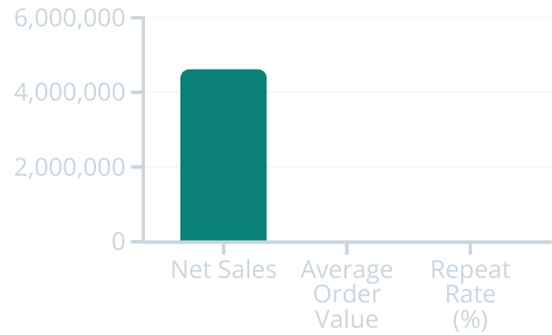
Key Performance Indicators Overview
This bar chart highlights key sales metrics: net sales surpass $4.6M, average order value is $618+, and repeat purchase rate stands at 21%. These KPIs signal solid revenue and a steady base of loyal customers, crucial for growth strategy and targeting.

Slide 12
Key Findings Summary
1
Net Sales
2
Customer Loyalty
Generated over $4.6M from 7,431 orders, showing strong revenue.
21% repeat buyers highlight robust brand loyalty and engagement.
3
Top Products & Cities
4
Payment & Timing
Climbing Shoes lead sales; Austin, Chicago, and San Francisco excel in revenue.
Shopify Payments dominate with 85% use; peak purchases occur 10 AM–2 PM.

Slide 13


Conclusion
This dashboard offers an interactive view of Shopify's sales data.
It combines Python EDA and Power BI visualization for business insights.
Understand Performance
Identify top products, cities, and payment methods.
Track Loyalty
Monitor customer purchasing patterns and engagement.
Data-Backed Decisions
Improve revenue, efficiency, and customer satisfaction.

Slide 14



Thank You
We appreciate your time and interest in our Shopify Sales Dashboard Report.
Your feedback and questions are welcome to ensure continuous improvement and success.
Stay Connected
Next Steps
Feedback
Reach out for further insights and support anytime.
Implement data-driven strategies to boost sales and customer loyalty.
Your input helps us tailor solutions to your needs.

